Slide 1
Capstone Project - Washington activities
Applied Data Science Capstone by IBM/Coursera
- Miguel Lemos

Slide 2
Introduction: Business Problem
In this project we will try to find an optimal location for activities in Washington.
Since there are lots of activities as restaurant, theaters and bars near from his hotel in Washington we will try to detect locations where they can make more activities as close to city center as possible, assuming that first two conditions are met.

Slide 3
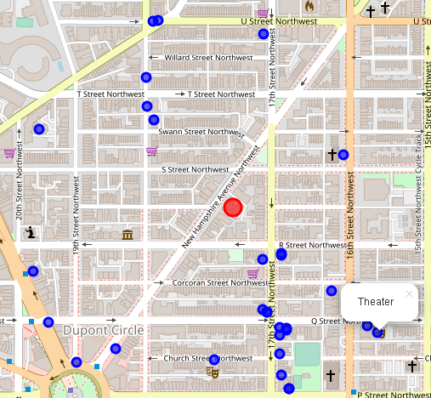
Data
Based on definition of our problem, factors that will influence our decission are:
number of existing restaurants in the neighborhood (any type of activities)
number of and distance to Italian restaurants in the neighborhood, if any
distance of neighborhood from city center
We decided to use regularly spaced grid of locations, centered around city center, to define our neighborhoods.
Following data sources will be needed to extract/generate the required information:
centers of candidate areas will be generated algorithmically and approximate addresses of centers of those areas will be obtained using Google Maps API reverse geocoding
number of activities and their type and location in every neighborhood will be obtained using Foursquare API
coordinate of Washington center will be obtained using Google Maps API geocoding of well known Washington location
Venues: https://foursquare.com/

Slide 4
Methology
In this project we will direct our efforts on detecting areas of W. DC, where the scientist can visit fast and secure.
In first step we have collected the required data: location and type (category) of every restaurant within 6km from Washinton. We have also identified Italian restaurants (according to Foursquare categorization).
Second step in our analysis will be calculation and exploration of 'restaurant density' across different areas of Berlin - we will use heatmaps to identify a few promising areas close to center with low number of restaurants in general (and no Italian restaurants in vicinity) and focus our attention on those areas.
In third and final step we will focus on most promising areas and within those create clusters of locations that meet some basic requirements established in discussion with stakeholders: we will take into consideration locations with no more than two restaurants in radius of 400 meters. We will present map of all such locations but also create clusters (using k-means clustering) of those locations to identify general zones / neighborhoods / addresses which should be a starting point for final 'street level' exploration and search for optimal venue location by stakeholders.

Slide 5
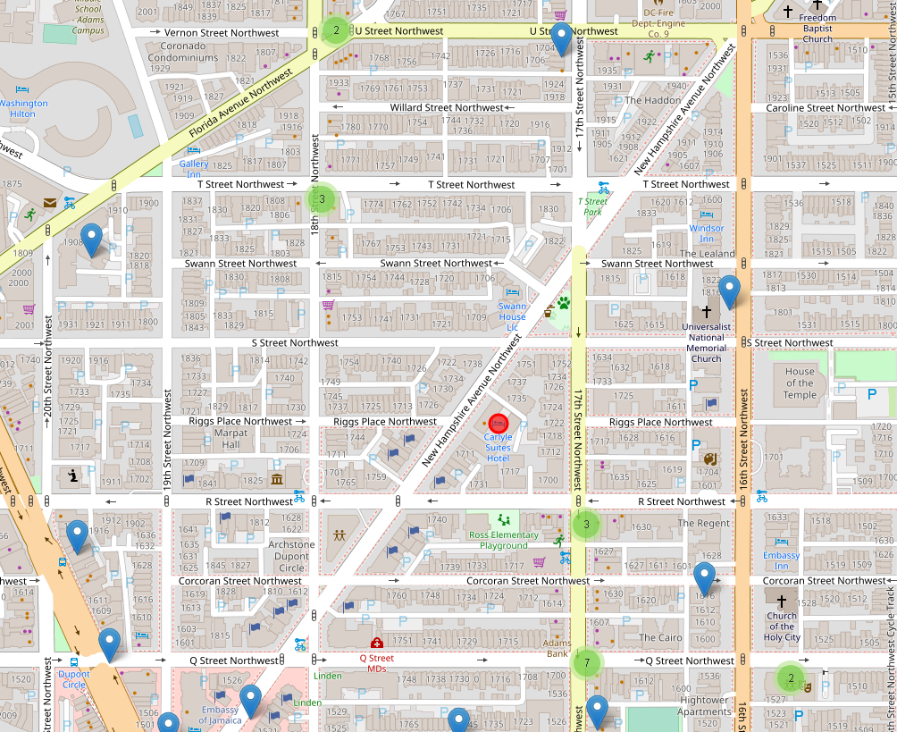
Analysis

Slide 6
Results and Discussion
One venue of interest is around of 250mts and near of this, around of 100mts, would visit another 6 sites, distributed, this is the best options in the map.

Slide 7
Conclusion
the scientist have so many options, but using python will have the best option to meet venues in the city, alround of 14 places can be know by them

